Slide 1
Session 10
JSON in Real World

Slide 2
Objectives
Describe the support of different browser and programming languages for JSON
Describe JSON content types
Explain how to use JSON for Web and Data Storage
Compare JSON with relational databases
Identify security and data portability issues with respect to JSON
<?xml>

Slide 3
Support for JSON
Each major programming language can incorporate JSON, natively or through libraries.
This is possible by incorporating two functionalities namely:
Parsing
Formatting
<?xml>
Notes:
Incorporate : ket hop

Slide 4
JSON with C# and Java
These languages support statically typed classes and not objects of HashMap or Dictionary type.
The solution is to use a library along with a custom code for converting these structures into static type instances.
The Gson library from Google is one such library that resolves the issue.
<?xml>

Slide 5
What is Gson
Is an open-source Java library for transforming a Java object to JSON data and vice-versa.
Offers easy mechanisms such as constructor (factory
method) and toString().
Functions well with arbitrary Java objects, involving the pre-existing ones.
Serializes and deserializes huge data without any issues. Is convenient to learn and use by only using toJson()
and fromJson().
<?xml>

Slide 6
JSON with PHP
From 5.2.0 version, the extension for JSON is packaged into PHP.
Following table shows the functions for encoding and decoding JSON structures:
Function | Description
json_encode | Serializes the stated array or object and returns it in the JSON format if successful or FALSE.
json_decode | Deserializes JSON data and returns the suitable PHP type.
json_last_error | Returns the error that happened last.
<?xml>

Slide 7
MIME Type of JSON
Is also called media type or content type.
Is a two-part identifier composed of a type
and subtype isolated by a slash.
Aids in identifying the type of formatted content being sent over the Web.
Is ‘application/json’ for JSON.
Is unofficially ‘text/json’ or ‘text/Javascript’.
<?xml>

Slide 8
Applications of JSON
APIs
For exchanging data to and from APIs
Popular in social networking sites implementing API
NoSQL
For storing data easily in NoSQL databases, as JSON is easily convertible into JavaScript
Asynchronous JavaScript and JSON (AJAJ)
For replacing XML when new data is fetched by a loaded Web page in a browser
For replacing Simple Object Access Protocol (SOAP) or XML-RPC and for sending several calls and notifications to a server
JSON-RPC (Remote Procedure Call )
For storing metadata
Package Management
<?xml>

Slide 9
JSON HTTP and Files
JSON displays the data fetched from a Web server efficiently through the XMLHttpRequest object.
The object exchanges data in the background, which prevents reloading the full page for updates.
Following is the syntax of initializing the object:
variable = new XMLHttpRequest();
<?xml>

Slide 10
JSON for Data Storage
JSON helps in storing data fetched from services and applications.
Reasons: Simplicity and ‘just adequate structure’
RDBMS and Structured Query Language (SQL) are now replaced by NoSQL databases for developers who prefer JSON.
Trends: More implementation of JSON-centric
document databases, JSON in traditional RDBMS’
Reasons: Developer-friendly and agility
<?xml>

Slide 11
Document versus Relational Databases
 | Document-oriented Databases | Relational Databases
Coupling | Tighter due to the need to navigate the document while querying | Loose
Portability and Standardization | No, due to new query language setup for each document store | Yes, due to well-defined SQL query core
Optimization | Restricted, due to no abstraction between the logical data structure and its physical storage | Fully optimized, due to abstraction ensured by highly queryable stored data definition
Consistency and Normalization | No, due to no support for constraints | Yes
<?xml>

Slide 12




Benefits of Using JSON in RDBMS
Decision Power for:
The data portions to be abstracted
Areas where flexibility is essential
Locations where strict schema and constraints are essential
JSON Query as Native SQL:
Allows querying randomly across JSON records in tables
Allows expanding
systems to use JSON
<?xml>

Slide 13
JSON versus RDBMS Data Models
 | JSON | RDBMS
Storage Structure | Is array or object. | Is a table.
Metadata | Can be in a schema, but is not pre-created. | Is stored in a schema generated while creating a table.
Data Retrieval | Uses evolving languages namely, JSON Query Language (JAQL) and JSONiq | Uses SQL.
Sorting | Is only for arrays. | Is for tables.
Learning Curve | Is smoother. | Is time consuming.
Application | Is used in several programming languages. | Is in the form of many commercial and open- source databases.
<?xml>

Slide 14
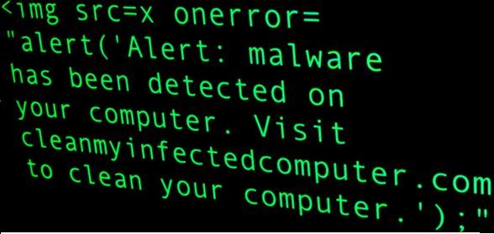
Security Issues in JSON
JSON, as a flexible subset of JavaScript, has some security issues.
In the following figure the root cause increasing the risk of malicious script, a
v^{m}ar^{aj}dºa^{r}t^{i}a^{ssu}=^{e}e: val('(' + JSONresponse + ')');
<?xml>

Slide 15
Issues with Eval()
Most JSON text is syntactically JavaScript.
JavaScript interpreter converts JSON into a
JavaScript object without validation.
This increases the risk of authentication forgery, identity and data theft, and misuse of resources.
Solution: JSON.parse() and JSON.stringify() functions processing text only in JSON format
<?xml>

Slide 16
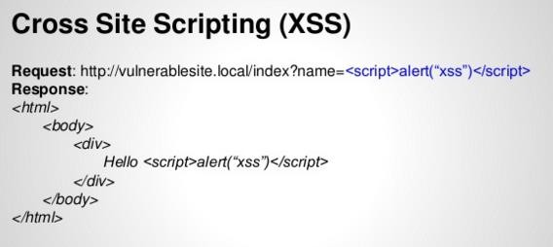
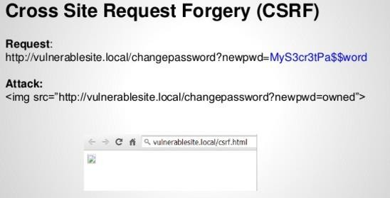
XSS and CSRF Issues
<?xml>

Slide 17
XSS and CSRF Solution
By using the jsonify() function
<?xml>

Slide 18
Implementation Issues
Denial of Service (DoS) Attack
Renders a resource or a machine on a network unavailable to its targeted users
Mass Assignment Vulnerability
Maltreats the functioning pattern of record in a Web application for illegitimately changing confidential data items
<?xml>

Slide 19
Portability Issues
Unicode Line Terminators
Null Character
UTF
Encoding
JSON
Numbers
Unsupported Data Types
Are allowed in JSON without being escaped and that they need to be backslash escaped for portability.
Is allowed in JSON string if escaped as “\u0000”, which creates issues with C strings.
Involves having a few escaped characters using UTF-16 surrogate pairs, which a few JSON parsers do not recognize.
Involve numbers and floating integers, which are distinguished by some languages only, not by all.
Have no specifications for rounding, overflow, and precision loss.
Involve Error, Date, Undefined, Function, and Regular Expression, which JSON does not accept.
<?xml>

Slide 20
Handling JSON Securely
Avoiding eval() by using a JavaScript library available at www.json.org, such as JSON sans eval()
Ensuring data integrity via XMLHttpRequests
<?xml>

Slide 21
Summary 1-2
Modern programming languages incorporate JSON via libraries or native parsing support.
Gson is an open-source Java library for converting a Java object into JSON and vice- versa.
Formal MIME type for JSON text is ‘application/json’.
JSON is used in several applications, such as in APIs, NoSQL databases, RDBMS’, Web development, and application packages.
<?xml>

Slide 22
Summary 2-2
Unlike relational databases, JSON does not have tables, pre-created metadata, and support for SQL.
Using eval() for parsing JSON data can lead to security attacks such as XSS and CSRF.
JSON is prone to DoS attack and vulnerability of mass assignment.
Developers can secure JSON structures by replacing eval() with a JavaScript library and/or using XMLHttpRequests.
<?xml>

